Slide 1
GLP-1 & InBody
Case Studies and Insights from Korea
InBody Medical
Haemin CHOI
InBody HQ

Slide 2
Part 1
Part 2
Part 3
Introduction
Case Studies
Insights
01
02
03
01
02
03
Common Patient Type
Edema & Phase Angle Improvement
Diabetic Patient
Direct Feedback
Summary
Benefits of InBody
Muscle & Fat Mass
Edema
Phase Angle
01
02
03

Slide 3
Part 1
Introduction

Slide 4
InBody Key Indicators for Obesity and Diabetes
Muscle
& Fat Mass
Edema
Phase Angle

Slide 5
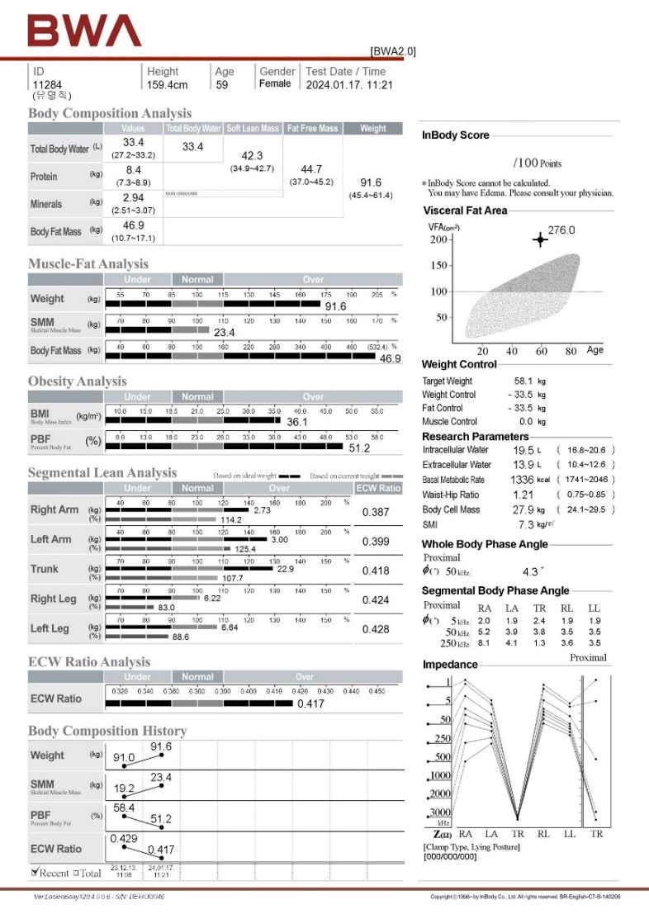
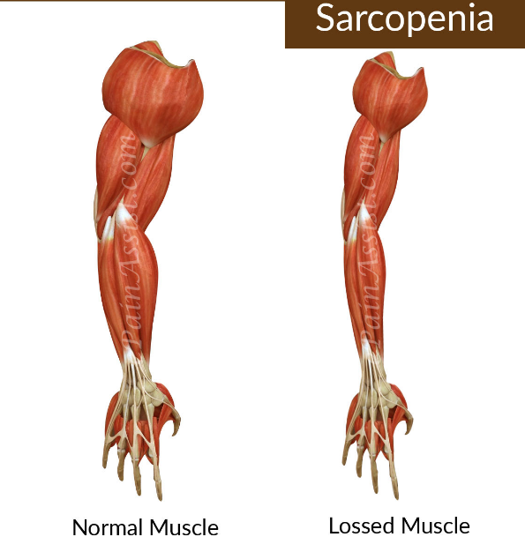
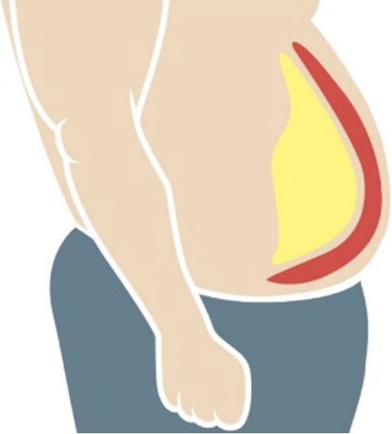
01
Muscle & Fat Mass
Body Composition
Visceral fat
√
Subcutaneous fat
Normal Muscle
Lost Muscle

Slide 6

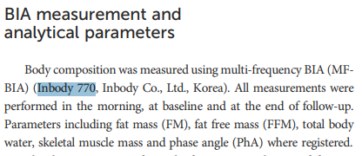
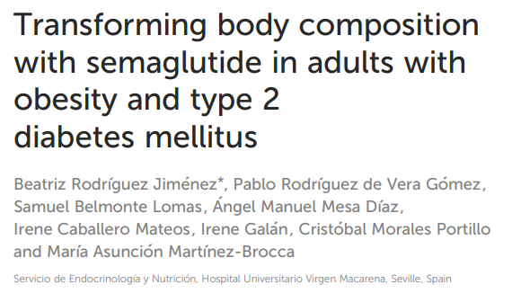
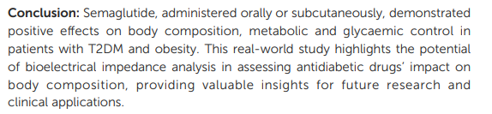
01
Muscle & Fat Mass
Effect of Semaglutide on Body Composition
[Key Finding]
Weight Loss
Fat Reduction
Phase Angle Stability
Improved Metabolic Parameters
Efficacy Across Administration Modes
[Conclusion]
Semaglutide demonstrated significant benefits in managing obesity and T2DM by reducing FM and improving metabolic parameters while preserving lean body mass.
Notes:
이 연구는 제2형 당뇨병(T2DM)과 비만 성인을 대상으로 세마글루타이드가 체성분과 대사 지표에 미치는 영향을 평가했습니다. 세마글루타이드는 글루카곤 유사 펩타이드-1 수용체 작용제(GLP-1ra)로, 24주 동안 경구 또는 피하 투여 방식으로 사용되었습니다. 연구는 지방량(FM), 제지방량(FFM), 골격근량, 총 체수분량, 위상각(PhA)에 미치는 영향을 중점적으로 분석했습니다.
This study assesses the impact of semaglutide on body composition and metabolic parameters in adults with type 2 diabetes mellitus (T2DM) and obesity. Semaglutide, a glucagon-like peptide-1 receptor agonist (GLP-1ra), was administered either orally or subcutaneously over 24 weeks. The focus was on its effects on fat mass (FM), fat-free mass (FFM), skeletal muscle mass, total body water, and phase angle (PhA).
경구 및 피하 투여 모두 유의미한 체중 감소(~9.5%)를 달성했으며, 주로 지방량 감소로 인해 발생했으며 제지방량은 유지되었습니다.
Both oral and subcutaneous administration achieved significant weight loss (~9.5%), primarily due to FM reduction while preserving lean mass.
내장지방 영역과 전체 지방량에서 상당한 감소가 관찰되었습니다.
Substantial reductions in visceral fat area and overall FM were observed.
치료 중 PhA는 안정적으로 유지되어 세포 무결성이 유지됨을 나타냈습니다.
PhA remained stable, indicating maintained cellular integrity during the treatment.
HbA1c, 공복 혈당, 지질 프로파일이 유의미하게 개선되었습니다.
HbA1c, fasting glucose, and lipid profiles improved significantly.
경구와 피하 투여 방식 간에 유사한 결과가 관찰되었습니다.
Comparable outcomes were observed between oral and subcutaneous administration routes.

Slide 7
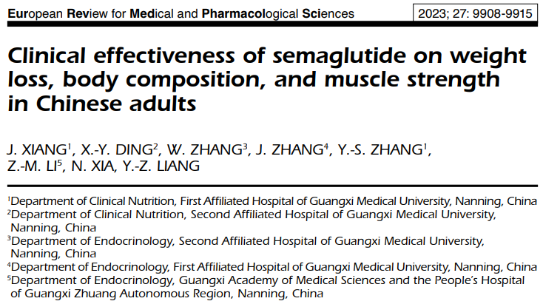
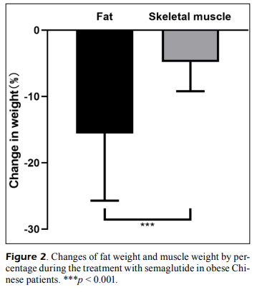


01
Muscle & Fat Mass
Efficient Fat Reduction with Muscle Mass Preservation
→ Used: InBodyS10
※ Skeletal Muscle mass Index (SMI) was an important index to evaluate the muscle content of the human body
Notes:
세마글루타이드는 체지방을 효과적으로 감소시키면서 골격근량과 근력을 유지하여 비만 치료에 유망한 치료 옵션을 제공합니다.
Semaglutide effectively reduces body fat while preserving skeletal muscle mass and strength, offering a promising treatment for obesity in a real-world setting.

Slide 8
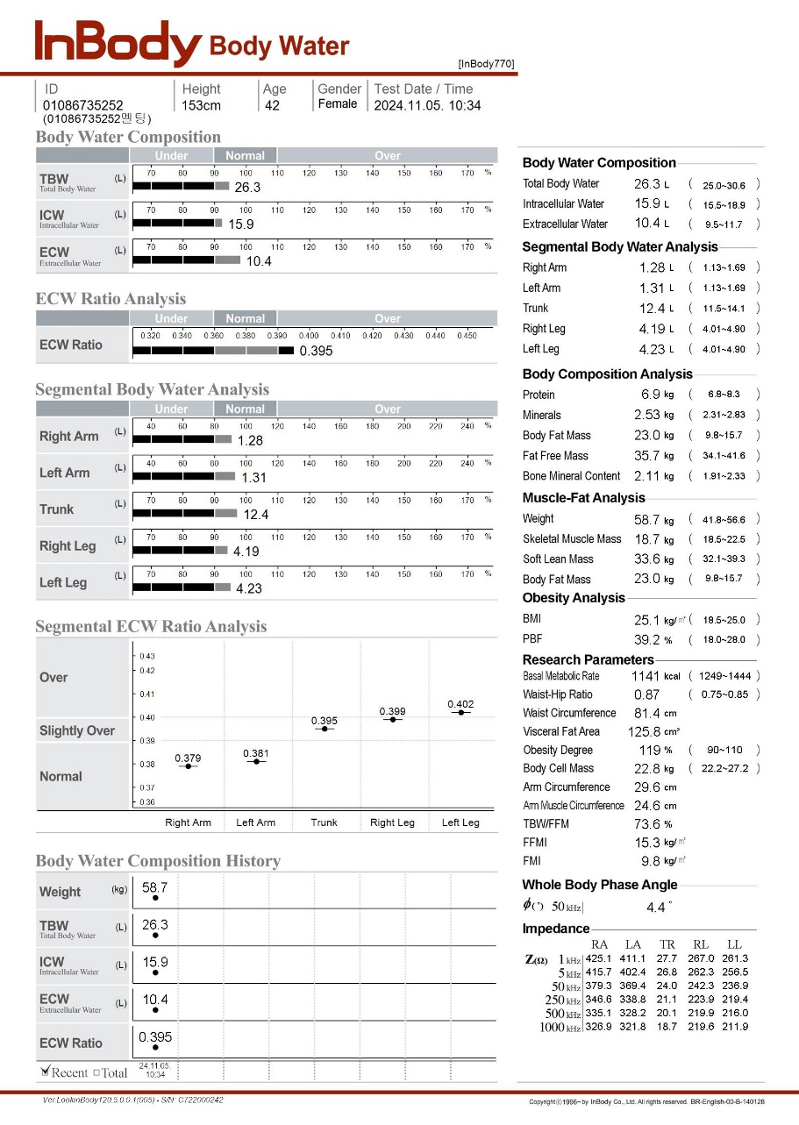
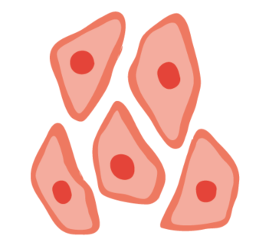
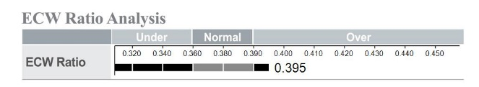
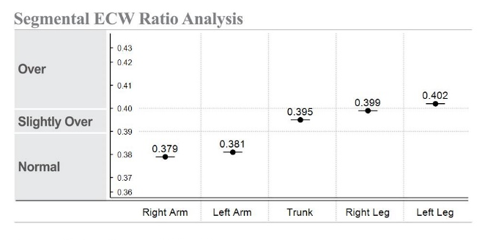
02
Edema
Fluid Distribution
Intracellular water
ICW
Extracellular water
ECW
Normal healthy people
ECW/TBW = 0.380
Edema
ECW/TBW > 0.390
Extracellular water
(ECW)
Fluid overload
Extracellular water
(ECW)
380
____
620
397
____
603
Eu-hydrated Fat Free Mass
Intracellular water
(ICW)
Edematous Fat Free Mass
Intracellular water
(ICW)
Protein + Minerals
Protein + Minerals

Slide 9
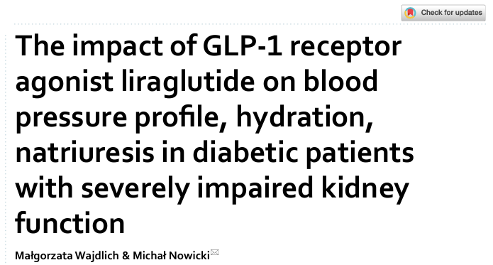
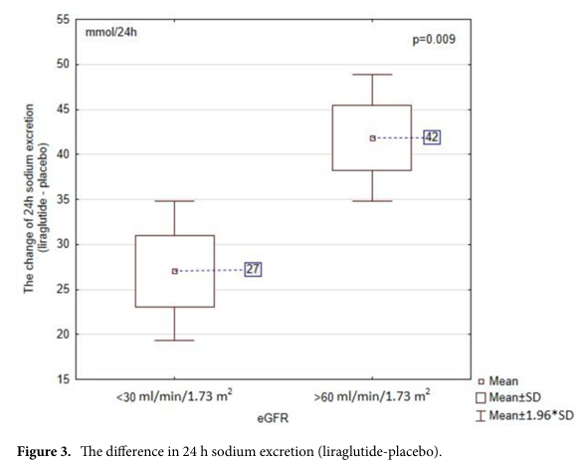
02
Edema
Liraglutide Enhances Sodium Excretion
→ Liraglutide enhances sodium excretion and helps maintain fluid balance, but this effect is more pronounced in individuals with healthy kidney function
→ This study investigates the effects of the GLP-1 receptor agonist liraglutide on blood pressure, hydration, and natriuresis in diabetic patients with severely impaired kidney function.
※ Conclusion: This study suggests that liraglutide can enhance sodium excretion and regulate fluid balance, but its effects on blood pressure differ depending on kidney function.
Notes:
*설명*
eGFR(사구체 여과율)이 30ml/min/1.73m² 미만인 환자군(심한 신장 기능 저하)과 60ml/min/1.73m² 이상인 환자군(정상에 가까운 신장 기능)으로 나누어 각각 리라글루타이드 1.2mg 또는 위약(placebo)을 단회 투여한 후 24시간 동안 혈압 및 나트륨 배설을 모니터링함.
리라글루타이드는 나트륨 배설을 촉진하는 효과가 있음.
하지만 **신장 기능이 낮은 사람(eGFR <30)**은 나트륨 배설 증가량이 적음(평균 27 mmol/24h).
반면, **신장 기능이 좋은 사람(eGFR >60)**은 나트륨 배설이 더 많이 증가(평균 42 mmol/24h).
결국, 신장 기능이 낮은 사람은 리라글루타이드를 사용해도 체내 나트륨과 체액을 효과적으로 조절하기 어려울 수 있음.
※ 신장기능이 안 좋은 사람은 리라글루타이드로 체액을 조절하기 어렵겠지만, 신장이 건강한 사람에게는 나트륨 배설을 증가시켜 체액 균형 유지에 도움이 될 수 있음.

Slide 10
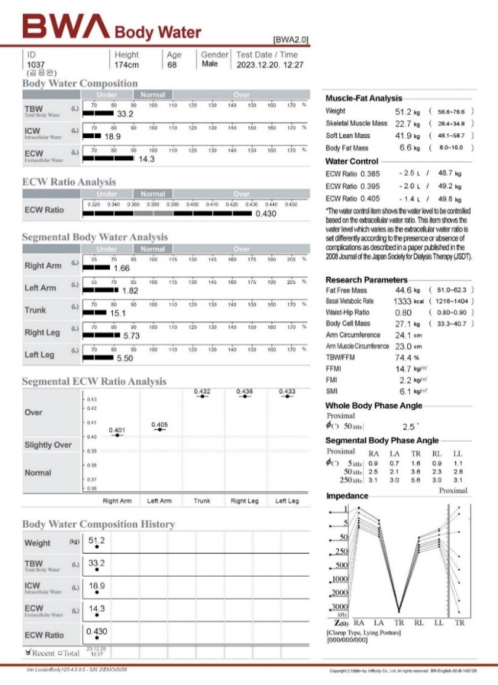
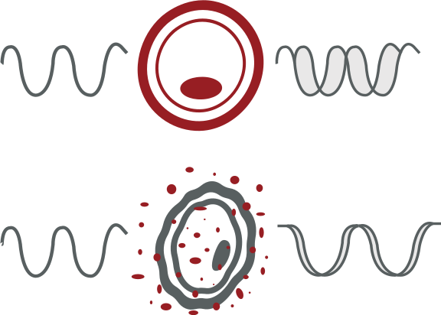
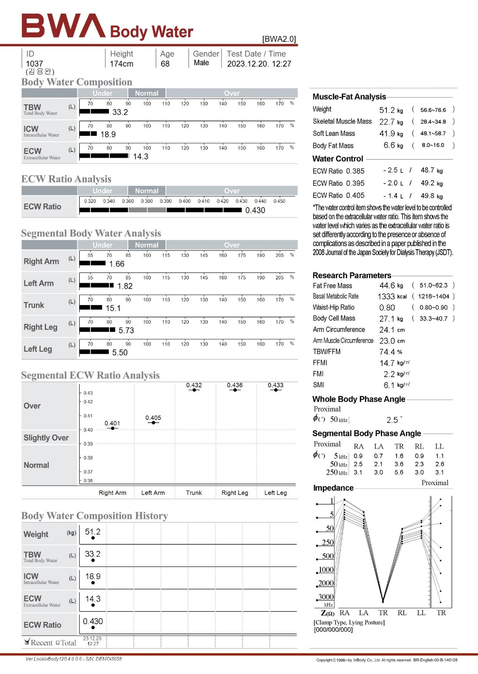
03
Phase Angle
Cell Membrane Intergrity
→ PhA represents structural integrity and
physiological functionality of the cells used for nutritional assessment
Healthy Cell
Damaged Cell
Membrane
U max
I max
50KHz
50KHz
Phase Angle
Intact cells with high membrane integrity
Damaged cell or low cell density
High Phase Angle
Low Phase Angle
Improvements in cell membrane and functionality → Phase angle increase
Deterioration cellular integrity and selective permeability → Phase angle decrease

Slide 11
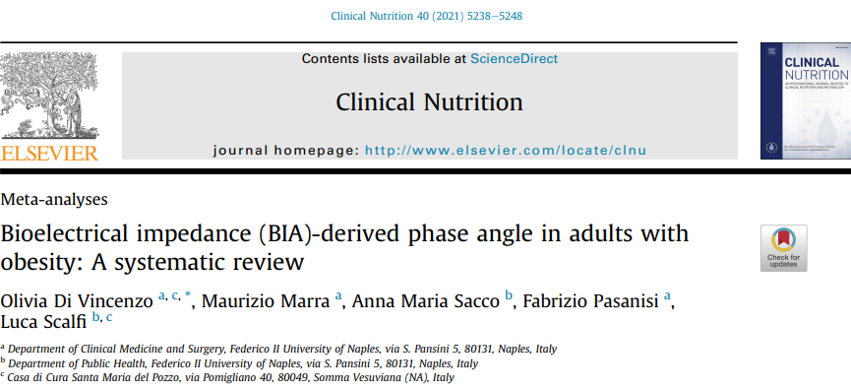
03
Phase Angle
Valuable Biomarker with Obesity
[PhA and Metabolic Health]
Lower PhA is linked to insulin resistance, impaired glucose metabolism, and dyslipidemia.
Higher inflammatory markers (CRP, IL-6, TNF-α) are associated with lower PhA.
More pronounced PhA reductions are observed in individuals with metabolic diseases.
Conclusion : phase angle (PhA) could be a valuable biomarker for assessing health status in individuals with obesity
→ PhA may be useful for monitoring nutritional status and muscle preservation during weight loss interventions.
→ Monitoring PhA changes in obesity treatment (diet, exercise, medication, or bariatric surgery) could be beneficial.
Notes:
결론: 위상각(PhA)은 비만 환자의 건강 상태를 평가하는 데 유용한 바이오마커가 될 수 있습니다.
→ 체중 감량 중재 중 영양 상태와 근육 보존을 모니터링하는 데 유용할 수 있습니다.
→ 비만 치료(식이 요법, 운동, 약물 치료, 비만 수술)에서 PhA 변화를 모니터링하는 것이 도움이 될 수 있습니다.

Slide 12
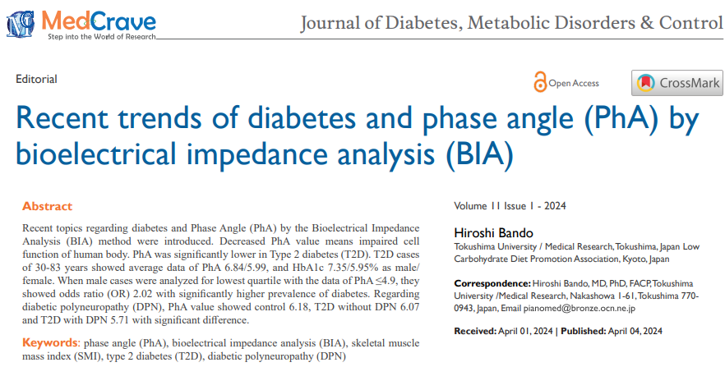
03
Phase Angle
Critical Insights in Diabetes
[Conclusion]
PhA from BIA offers critical insights
into cellular health and metabolic status in diabetes,
establishing its value as a diagnostic and prognostic
marker in clinical settings.
Patients with T2DM have lower PhA levels compared to non-diabetic individuals
Prolonged duration of diabetes is associated with a more pronounced decline in PhA
Patients with diabetes complications have lower PhA levels compared to the healthy group
PhA can serve as an indicator to assess the risk and progression of diabetes-related complications
Notes:
PhA와 당뇨병 (PhA and Diabetes)
제2형 당뇨병(T2DM)을 가진 개인은 비당뇨인에 비해 PhA가 낮습니다.
PhA is lower in individuals with Type 2 Diabetes Mellitus (T2DM) compared to non-diabetic individuals.
당뇨병의 지속 기간이 길수록 PhA 감소가 더 두드러져 세포 기능 저하를 나타냅니다.
Longer duration of diabetes is associated with a greater decline in PhA, indicating progressive cellular dysfunction.
당뇨병성 다발성 신경병증(DPN) (Diabetic Polyneuropathy (DPN))
DPN을 가진 T2DM 환자의 PhA 값은 DPN이 없는 환자와 건강한 대조군에 비해 유의미하게 낮습니다.
PhA values are significantly lower in T2DM patients with DPN compared to those without DPN and healthy controls.
PhA와 신경전도 매개변수 간의 강한 상관관계가 관찰되어 DPN의 지표로서의 가능성을 뒷받침합니다.
A strong correlation exists between PhA and nerve conduction parameters, supporting its potential as a marker for DPN.
**
당뇨병성 다발성 신경병증(DPN)**은 당뇨병의 흔한 합병증 중 하나로, 혈당 조절이 잘 되지 않을 때 신경이 손상되는 질환이에요. 주로 손이나 발의 말초신경에 영향을 미치며, 증상으로는 저림, 화끈거림, 감각 둔화, 통증 등이 나타날 수 있습니다.
체성분과 대사 건강 (Body Composition and Metabolic Health)
PhA는 당화혈색소(HbA1c)와 공복 혈당 수준과 같은 당 조절 매개변수와 상관관계가 있습니다.
PhA correlates with glycemic control parameters such as HbA1c and fasting glucose levels.
근육량, 근력, 신체 기능성과 같은 지표와 긍정적인 관계를 보입니다.
It shows positive relationships with markers of muscle mass, strength, and physical performance.
임상적 활용 (Clinical Utility)
PhA는 당뇨병 관련 합병증(예: DPN 및 비알코올성 지방간 질환(NAFLD))의 위험 및 진행 상황을 평가하는 예후 도구로 활용될 수 있습니다.
PhA may serve as a prognostic tool for assessing the risk and progression of diabetes-related complications, including DPN and non-alcoholic fatty liver disease (NAFLD).
비침습적이고 비용 효율적인 방법으로 대사 건강 및 당뇨 관련 합병증을 모니터링하는 데 적합합니다.
It is a non-invasive, cost-effective method suitable for monitoring metabolic health and complications in diabetic populations.

Slide 13
Part 2
Case Studies
Wegovy & InBody770

Slide 14

Representative Case Categories
Case A
Case B
Case C
Individuals with
Common body composition
Patterns
Edema and Phase angle
Improvement type
Obesity with
Diabetes

Slide 15
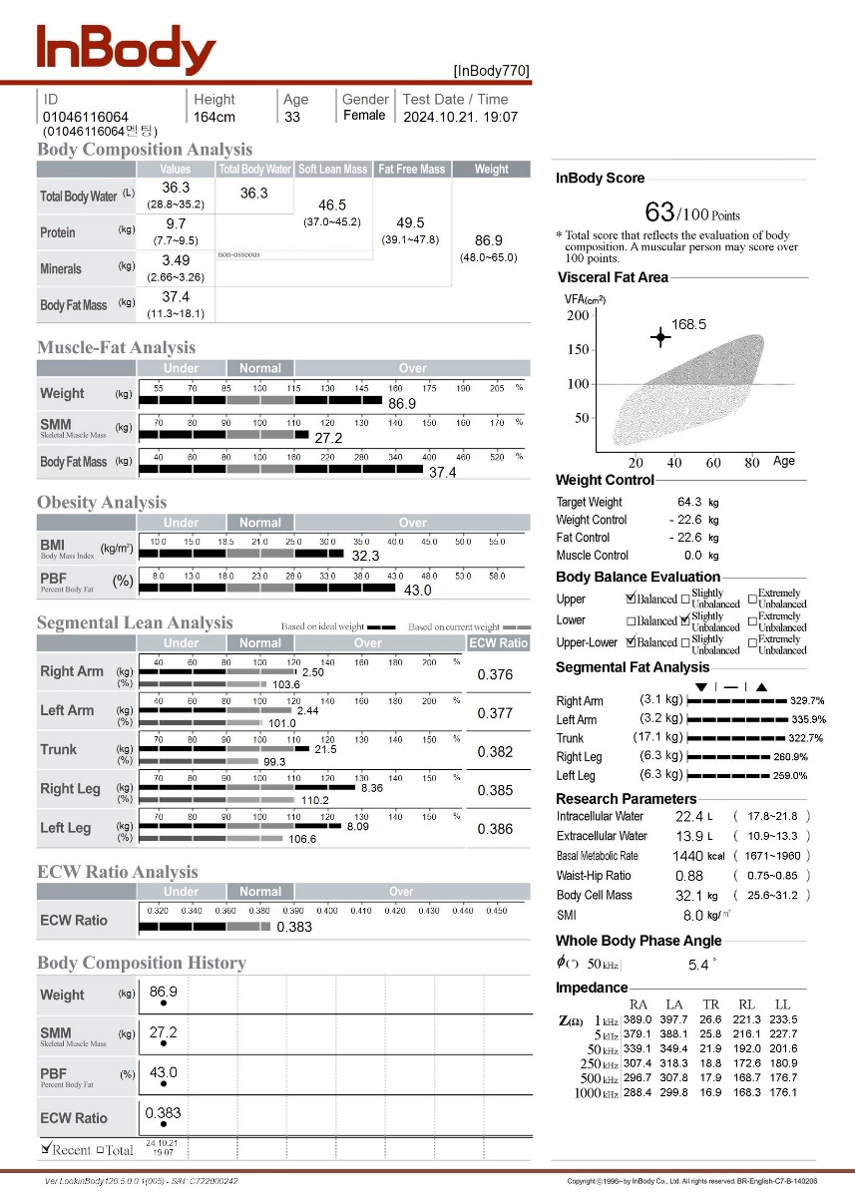
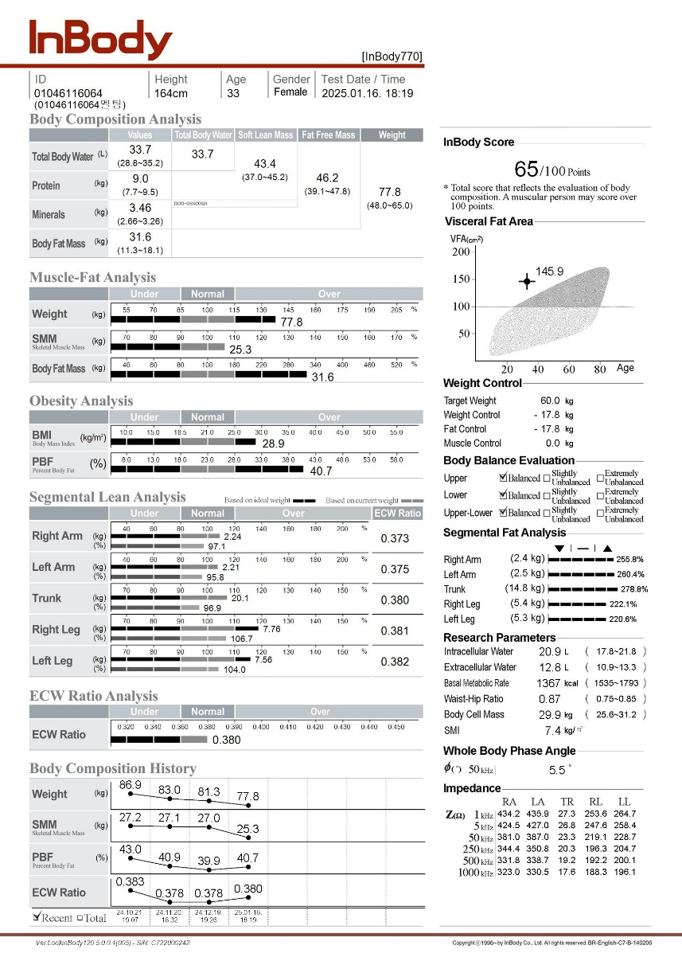
01
Case A
Common Patient Type
Before
After 14 weeks
SMM -1.9kg
BFM -5.8kg
F, 33, 164cm
Common type of treatment response
Steadily lost weight & boy fat, but muscle mass did not decrease as fat mass.
Weight: 86.9kg → 77.8kg (-9.1kg)
Skeletal Muscle Mass: 27.2kg → 25.3kg
Percent Body Fat: 43.0% → 40.7%
Phase Angle: 5.4º → 5.5º
Notes:
The first case is the common type of treatment response.
She steadily lost weight and body fat, but her muscle mass did not decrease as significantly compared to fat mass.
The doctor explained that this type of graph is a typical pattern seen in patients undergoing Wegovy treatment.
After 14 weeks, as a result among the 9kg of reduction, fat reduced 5.8kg and muscle mass reduced 1.9kg.

Slide 16
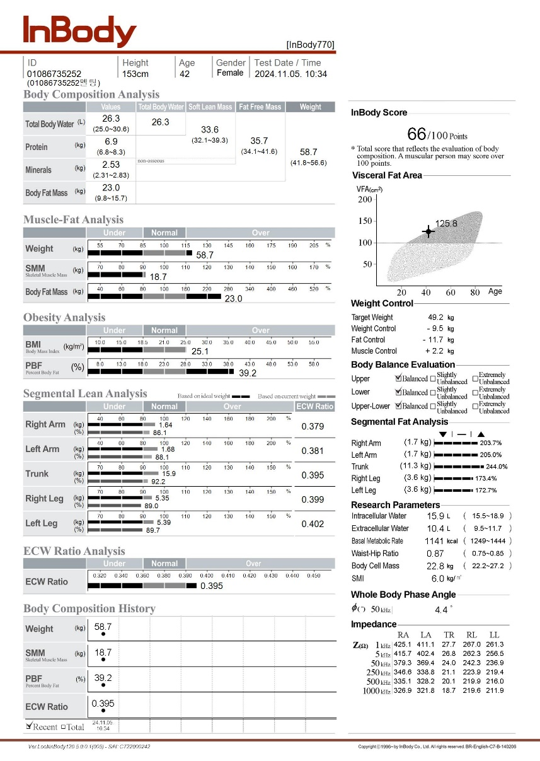
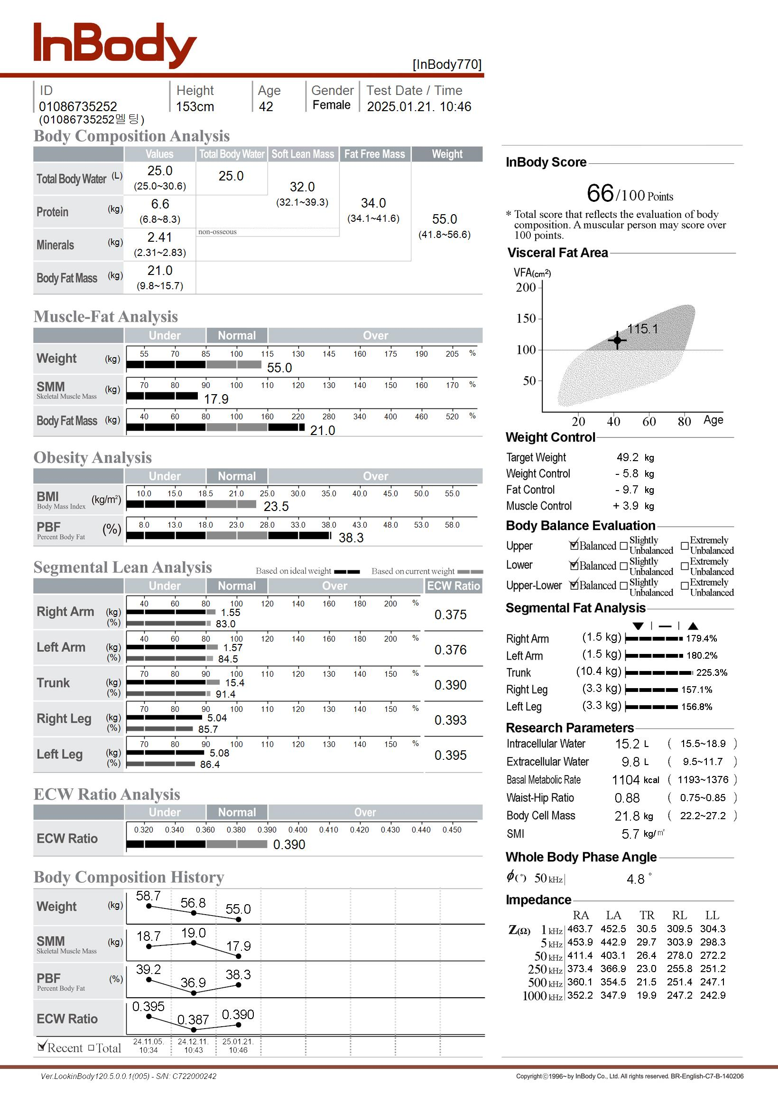
02
Case B
Edema & PhA Improvement
Before
After 11 weeks
SMM -0.8kg
BFM -2.0kg
F, 42, 153cm
Success with wegovy after failing other diet medications
Once her muscle mass dropped below average the treatment effect was not as effective
Doctor’s Comment
: Low muscle mass may indicate the body is not ready for effective dieting
Weight: 58.7kg → 55.0kg (-3.7kg)
Skeletal Muscle Mass: 18.7kg → 17.9kg
Percent Body Fat: 39.2% → 38.3%
Phase Angle: 4.4º → 4.8º
Notes:
The second case is about a woman who had struggled with various weight loss medications but failed to achieve results—until she succeeded with Wegovy treatment.
But the important part of this result is that once her muscle mass dropped below average, the treatment effect was not as effective.
The doctor mentioned that low muscle mass may indicate that the body is not ready for effective dieting.
From her result sheet, she needs to be cautious about sarcopenia.
However, her phase angle showed improved 0.4 degree during treatment, it means that her metabolic health is overally fine so the thing she need to focus is increase her muscle mass for better treatment

Slide 17
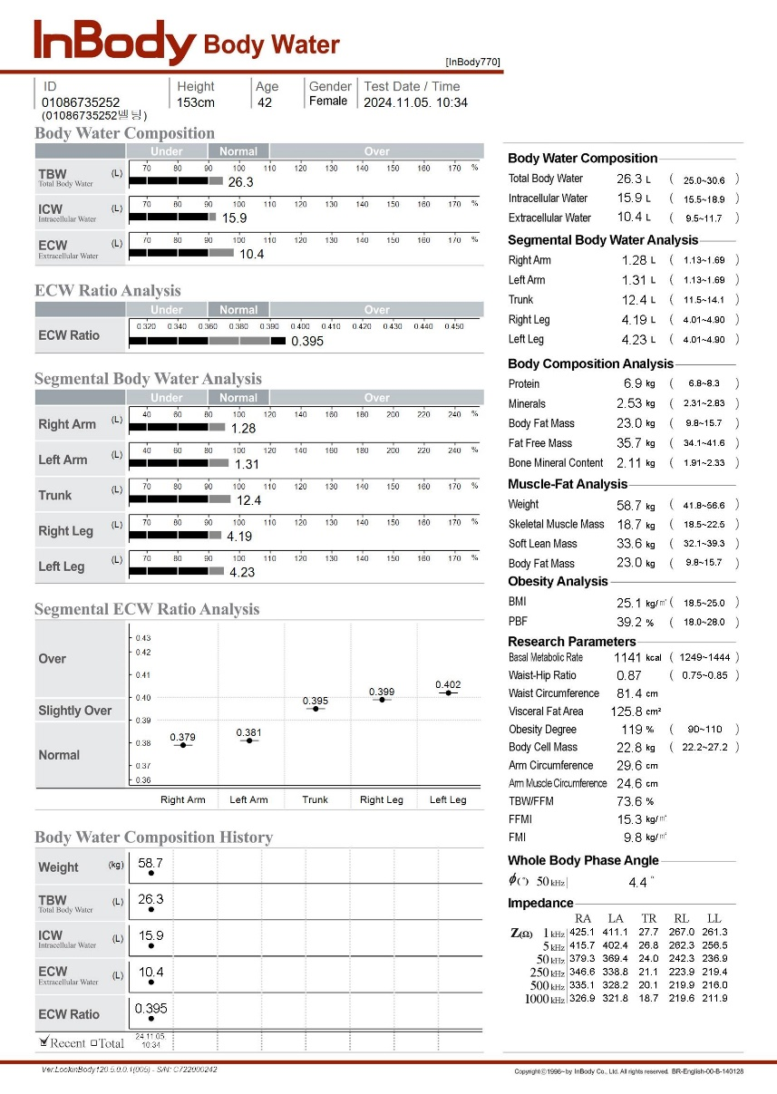
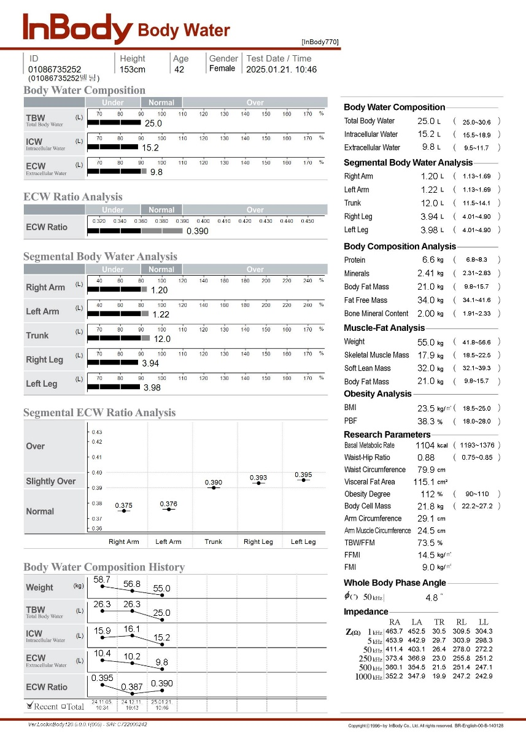
02
Case B
Edema & PhA Improvement
Before
After 11 weeks
F, 42, 153cm
ECW Ratio improved to the Normal range
Segmental ECW Ratio improved overall, significant improvement in lower limb
ECW(ExtraCellularWater)Ratio: 0.395 → 0.390
*Left Leg ECW Ratio: 0.402 → 0.395
Notes:
her ECW ratio also improved to the normal range
Segmental ECW Ratio improved overall, significant improvement in lower limb which shows severe edema

Slide 18
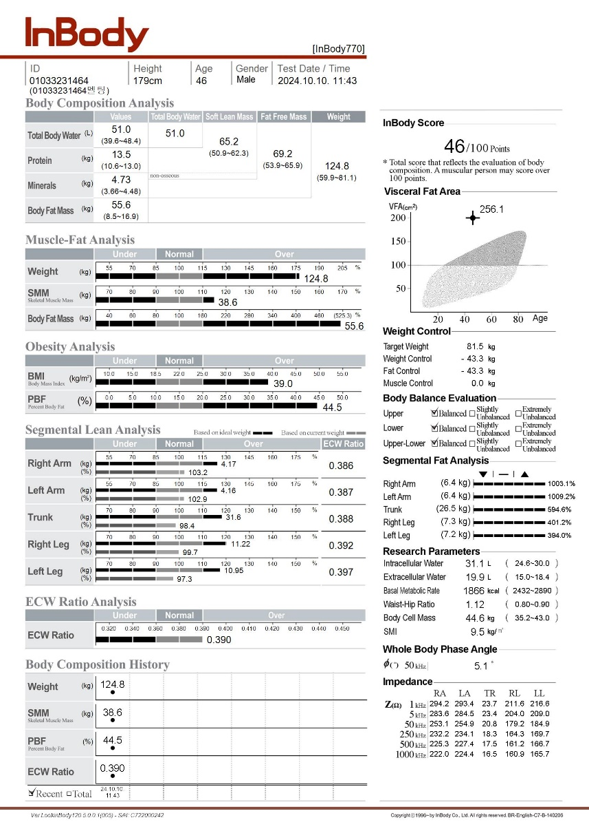
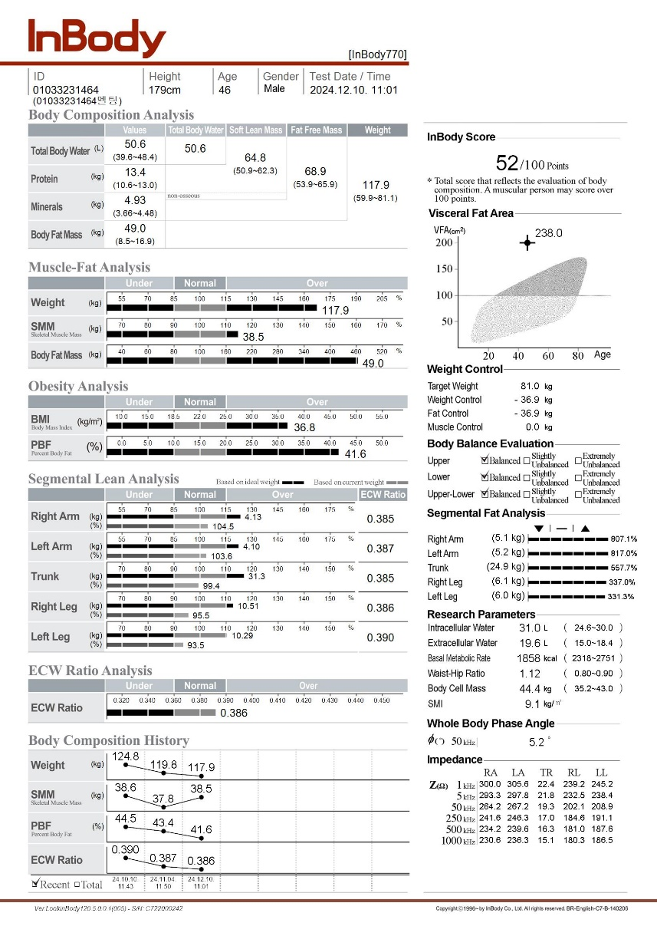
03
Case C
Diabetic Patient
Before
After 8 weeks
M, 46, 179cm, DM
Positive Outcome: Muscle mass is fully maintained while fat and weight decrease
Weight loss is slower than expected, resulting in low patient satisfaction
Weight: 124.8kg → 117.9kg
Skeletal Muscle Mass: 38.6kg → 38.5kg
Percent Body Fat: 44.5% → 41.6%
Phase Angle: 5.1º → 5.2º
Notes:
According to the doctor, many obese patients also have diabetes.
As we can see from the body composition history below, the patient's weight and fat mass have been steadily decreasing,
while muscle mass has been well maintained.
From our perspective, this patient's results were very positive to maintain this treatment.
However, the patient's satisfaction was not as high, because the weight loss was slower than expected, leading to lower satisfaction.

Slide 19
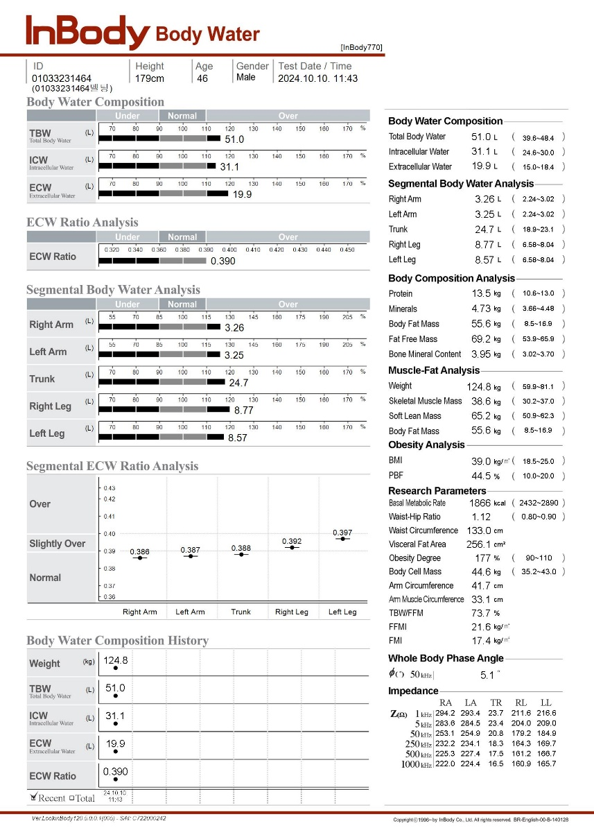
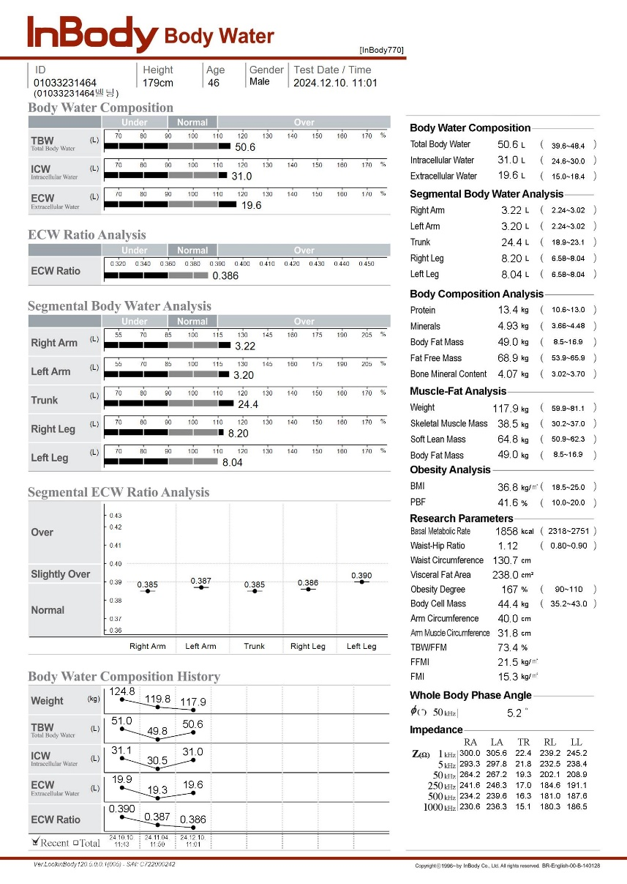
03
Case C
Diabetic Patient
Before
After 8 weeks
M, 46, 179cm, DM
ECW Ratio still shows improvement even with the relatively lower edema level
Segmental ECW Ratio shows a more stable result depending on the treatment effect
ECW(ExtraCellularWater) Ratio: 0.390 → 0.386
Notes:
The edema levels of the diabetic patient also gradually and steadily improved.
ECW Ratio still shows improvement even with the patient has relatively lower edema level.
the overall segmental values showed a more stable improvement, which the doctor also found interesting.
Most of the expected outcomes from research papers were consistently validated in real patient cases.

Slide 20
Part 3
Insights
Notes:
sharing direct feedbacks from the field

Slide 21
01
Direct Feedback
Wegovy Patient Data
Common Trends | Effects | Side Effects
Fat-focused weight loss Lower muscle mass reduction Higher body fat loss percentage [Summary] Most diet medication cause both muscle and fat loss, but Wegovy stands out for preserving muscle while primarily reduction fat | Muscle Protection: Weight loss mainly from fat. Slow and Steady Loss: 1–2 kg per month, maintaining stability. Fewer side effects compared to other diet medication. | Reported issues: Nausea, reduced focus, fatigue. Positive Feedback: Many patients appreciate reduced appetite and smaller meal portions. Other: After Wegovy was launched in Korea in October 2024, one patient at this hospital discontinued its use due to skin rash.
Notes:
The data from the field
Gradual weight & fat loss, resembling a steady slope.
Food intake 가 줄었음.

Slide 22
01
Direct Feedback
Opinion from Practicing Physicians
Doctor’s Perspective
Other Notes
Patients with low BMI frequently struggle with muscle deficiency, and Wegovy could be a solution.
Muscle loss during dieting can lead to additional issues, such as mental health challenges.
Patients with diabetes-related edema experienced swelling reduction with GLP-1 treatment.
→ Some Saxenda users are reluctant to switch to Wegovy.
→ Patients with low phase angle and skin rash discontinued Wegovy. Further research and continuous monitoring of the correlation between Wegovy and phase angle are needed.
Notes:
The data from the field

Slide 23
02
Summary
Doctor’s Feedback
▲Advantages | Effective even for patients who have failed with other weight loss medications. Preserves muscle mass while steadily reducing fat compared to other medication. Minimal impact on patients' quality of life. Consistent weight loss without plateaus.
▽Disadvantages | Patients may feel dissatisfied due to smaller weight loss relative to the cost. Potential for side effects, though no major cases have been reported yet.
Notes:
Thailand Marketing 570 4 Utilizing InBody for GLP-1 marketing purposes
Brazil
Costa Rica
Mexico
Colombia
Czech Republic
Hungary
Russia
South Africa
Saudi Arabia

Slide 24
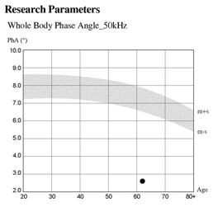
03
Benefits of InBody
What are the Benefits of using InBody?
1st
2nd
3rd
Ensures patient retention with reliable data for long-term GLP-1 monitoring.
Supports physicians with consultation tools and data-driven prescription decisions.
Enables personalized care through phase angle monitoring.
Supports Patients
in Maintaining treatment
Provides Comprehensive Consultation
Data for Physicians
Assesses Patient Condition
through Cellular Health

Slide 25
Thank you

